Slide 1
Linux testing made better with DATA
R Nageswara Sastry

Slide 2
Agenda
Problem Statement
What do we aim to achieve?
How did we achieve this?
Results

Slide 3
Problem Statement
Current regression test suites as part of the CR frameworks are static.
The turnaround time for one iteration/cycle can range from 3hrs to 12hrs.
Developers/Testers do not presently have a means to run quick and optimized testcases to validate a specific patch.
Common quality related questions that arise with current regression test suites have no answers:
What is the code coverage efficiency of a test case?
Which part of the code needs test cases to be developed?

Slide 4
What do we aim to achieve ?
Create dynamic regression test suites containing only such test cases that cater to a specific use-case.
Provide quick insights to testers/developers

Slide 5
Test case reduction method used
Coverage Based
Calculate the coverage
Take decision based on code coverage value

Slide 6
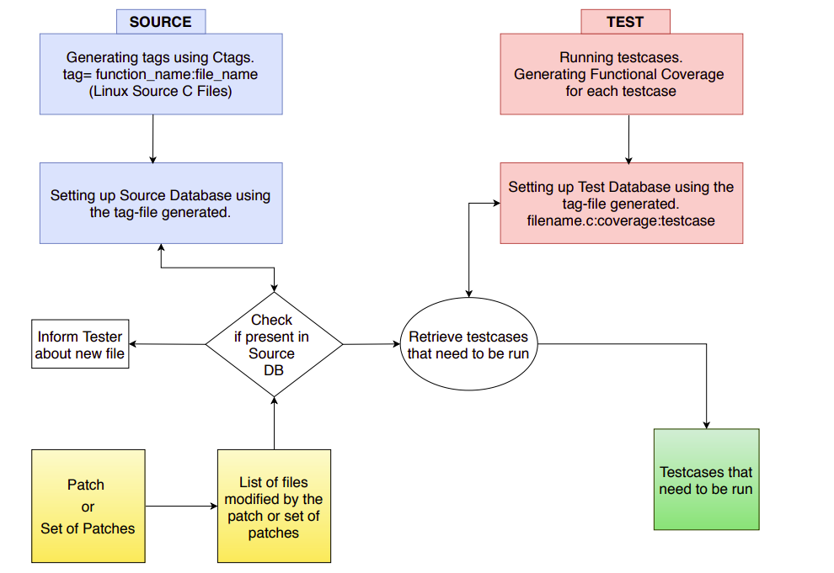
How did we achieve this ?

Slide 7
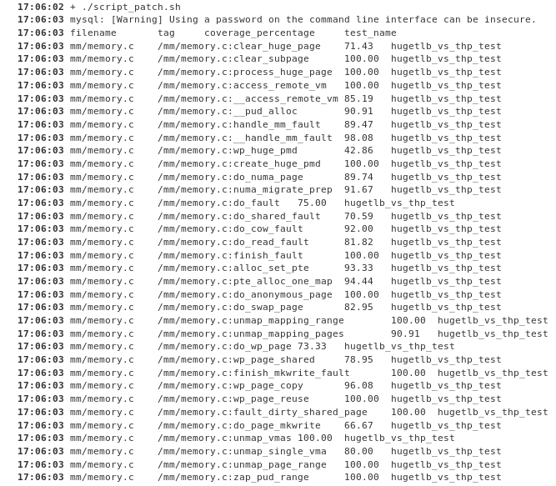
Automation
Input
Output

Slide 8
Source Database

Slide 9
Test Database

Slide 10
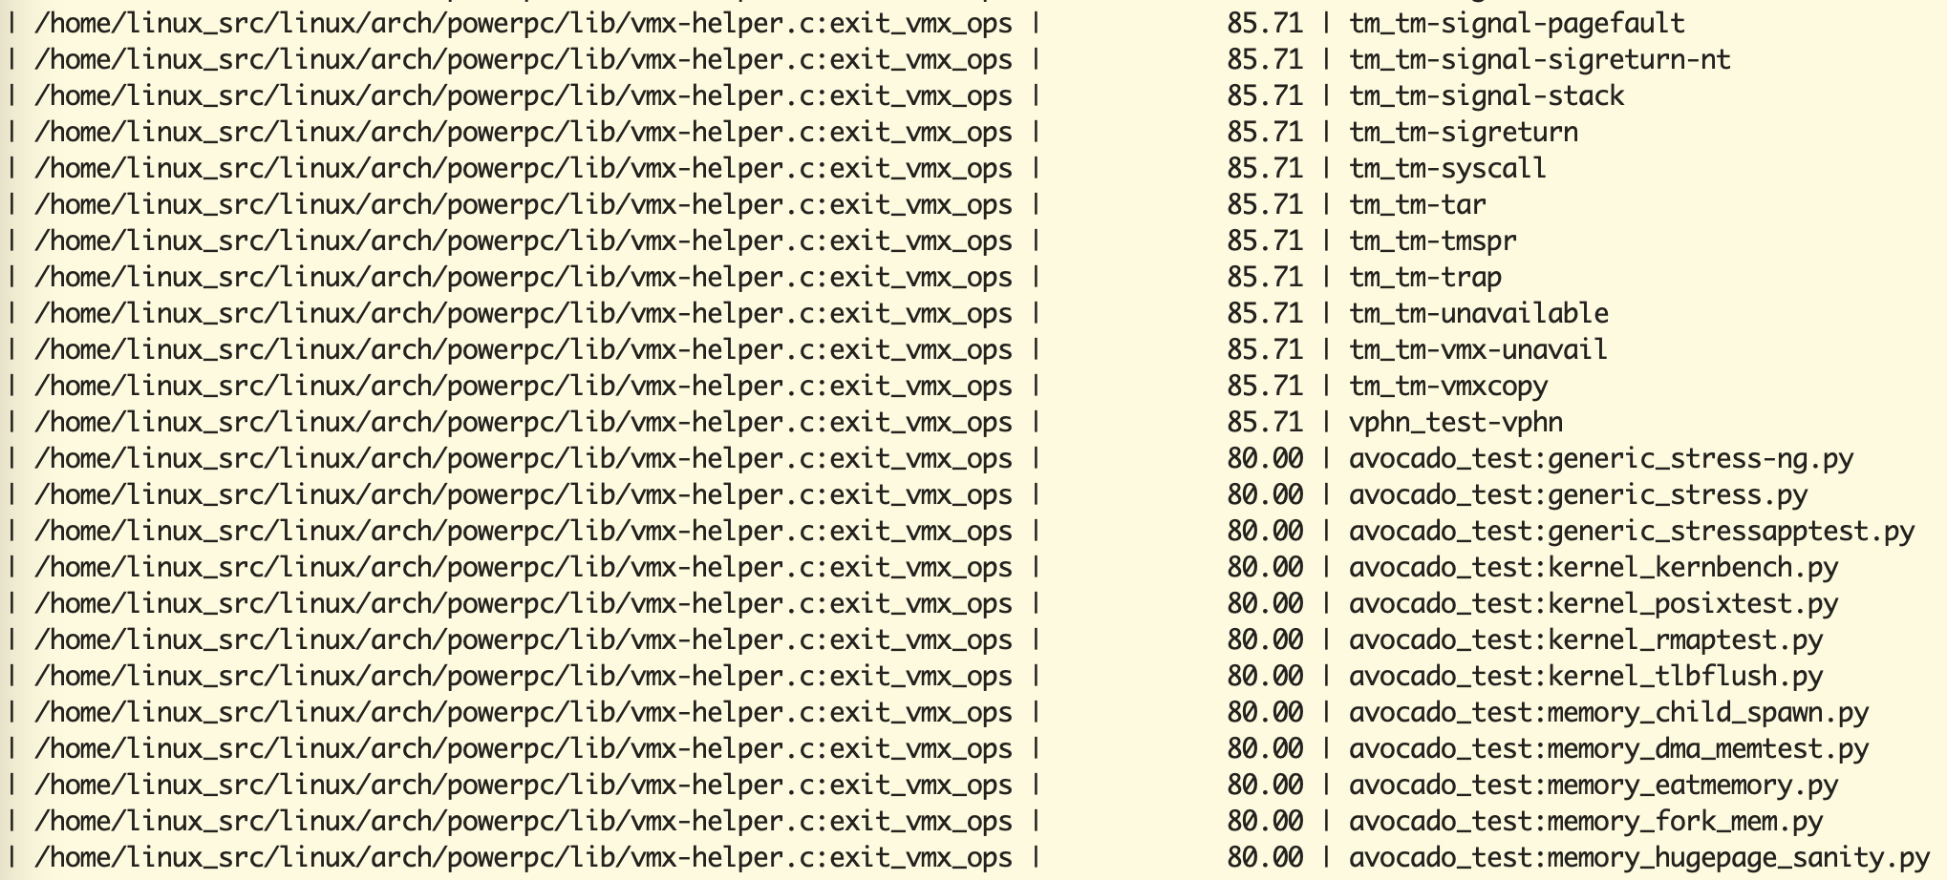
Redundant test cases

Slide 11
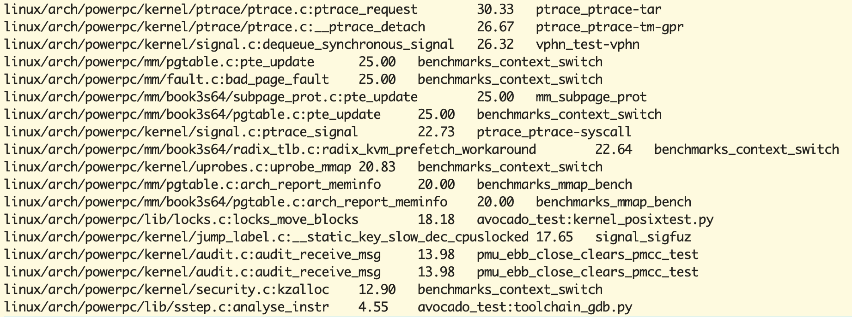
What test cases to improve

Slide 12
Results
Running 129 out of 1000 test cases is sufficient to get the same code coverage.
361 files out of 673 (54%) have code coverage of 100% using kselftests and avocado tests.
312 files out 673 (46%) have code coverage ranging from 96%-4%, so these tests need to be improved.

Slide 13
Disclaimer
. This work represents the view of the authors and does not necessarily represent the view of the employers (IBM Corporation)
. IBM and IBM (logo) are trademarks or registered trademarks of International Business Machines in United States and/or other countries.
. Linux is a registered trademark of Linux Torvalds.
. Other company, product and service names may be trademarks or service marks of others.

Slide 14
Thank You

